Slide 1
Backpacking with Code: Software Portability for DHTC
Christina Koch (ckoch5@wisc.edu)
Research Computing Facilitator
University of Wisconsin - Madison

Slide 2
Goals for this session
Understand the basics of...
how software works
where software is installed
how software is accessed and run
...and the implications for Distributed High Throughput Computing (DHTC)
Describe what it means to make software “portable”
Learn about and use two software portability techniques:
Build portable code
Use wrapper scripts

Slide 3
Motivation
running a piece of software is like cooking a meal in a kitchen

Slide 4

The Problem
Running software on your own computer = cooking in your own kitchen

Slide 5
The Problem
In your own kitchen:
You have all the pots and pans you need
You know where everything is
You have access to all the cupboards
On your own computer:
The software is installed, you know where it is, and you can access it.

Slide 6

The Problem
Running on a shared computer = cooking in someone else’s kitchen.

Slide 7
The Problem
In someone else’s kitchen:
You are guaranteed some things…
…but others may be missing
You don’t know where everything is
Some of the cupboards are locked
On a shared computer:
Your software may be missing, un-findable, or inaccessible.

Slide 8

The Solution
Think like a backpacker
Take your software with you
Install anywhere
Run anywhere
This is called making software portable

Slide 9
Software Basics
How do we make software portable?
First we have to understand:
What software is and how it works
Where software lives
How we run it

Slide 10
How Software Works
A software program can be thought of as a list of instructions or tasks that can be run on an computer
A launched program that is running on your computer is managed by your computer’s operating system (OS)
The program may make requests (access this network via wireless, save to disk, use another processor) that are mediated by the OS
A single program may also depend on other programs besides the OS

Slide 11
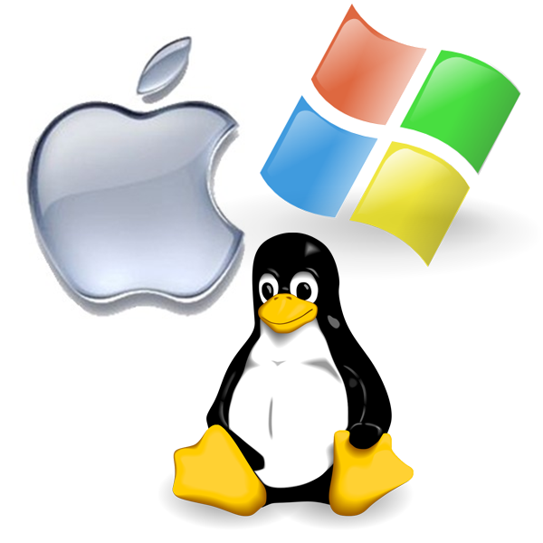

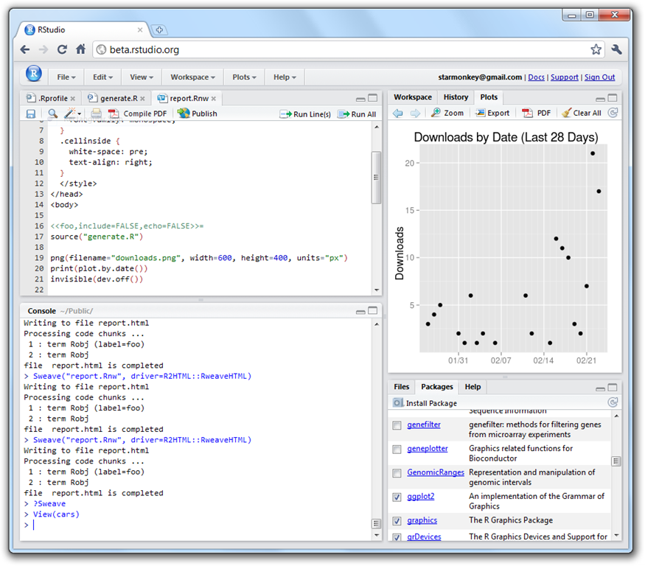
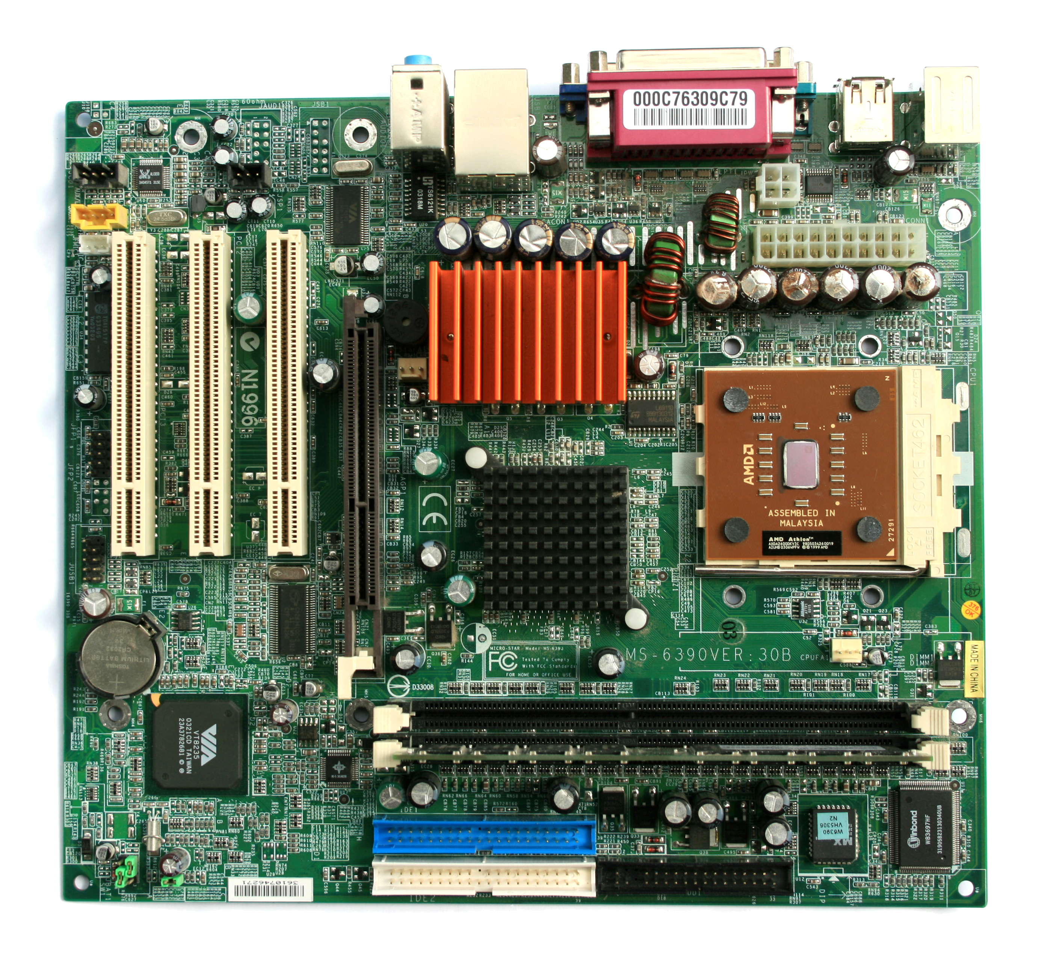

How Software Works*
*Not to scale
Program
(software, code, executable, binary)
Operating System
runs own tasks
translates program’s request
makes requests
launches to
monitors running programs
depends on
Hardware
(processors, memory, disk)
Running Program
(process, instance)

Slide 12
How Software Works
Implications for DHTC:
Software must be able to run on target operating system (usually Linux)
Request specific OS as job requirement
Know what else your software depends on

Slide 13
Location, location, location
Where can software be installed?
/
bin
usr
lib
programs
home
bin
local
fred
wilma
system locations
local locations

Slide 14
Location, location, location
Who can install the software?
/
bin
usr
lib
programs
home
bin
local
fred
wilma
Usually requires
administrative privileges
Owner of the
directory

Slide 15
Location, location, location
Who can access the software?
/
bin
usr
lib
programs
home
bin
local
fred
wilma
Anyone on the system
The local user can control who has access

Slide 16
Location, location, location
Implications for DHTC:
Software MUST be able to install to a local location
Software must be installable without administrative privileges

Slide 17
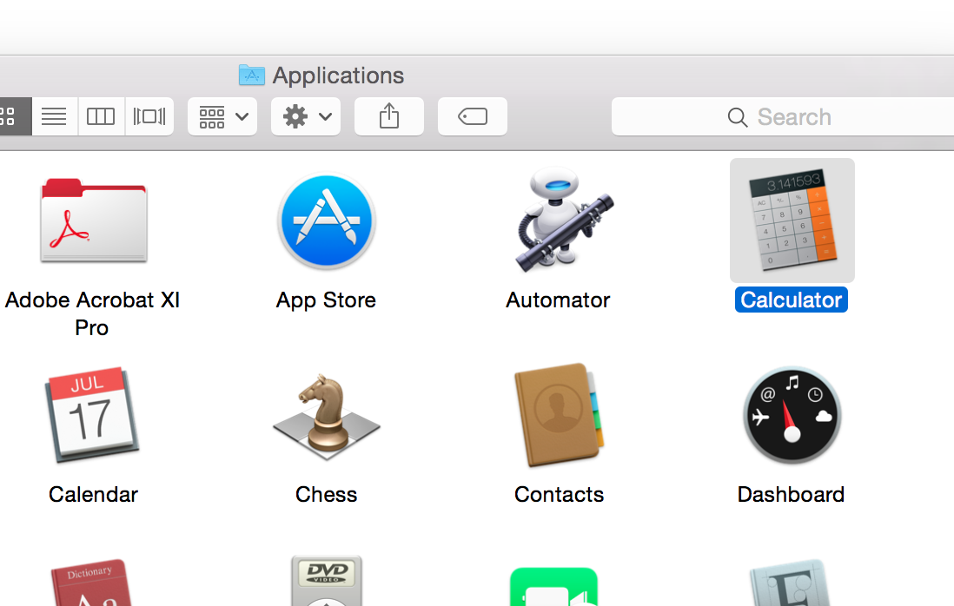
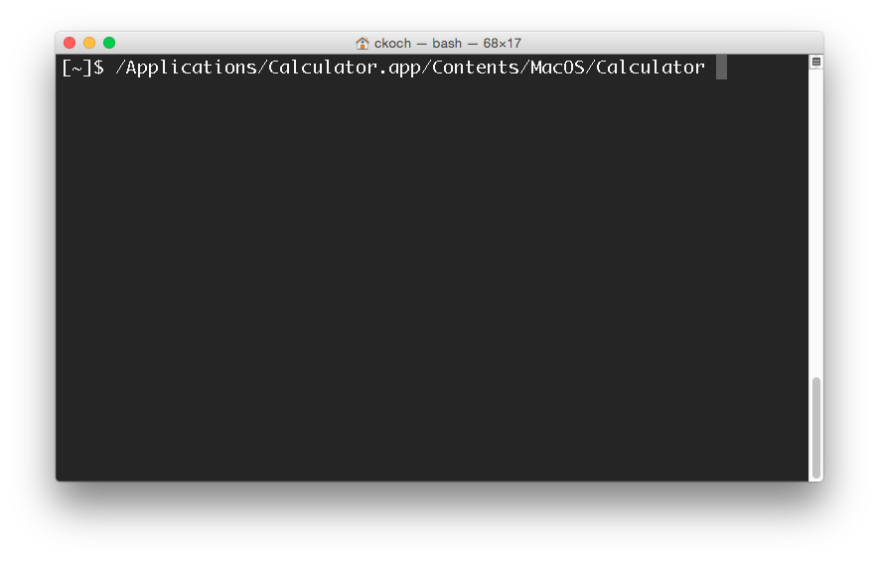
Command Line
Instead of graphic interface…
command line
All DHTC jobs must use software that can be run from the command line.
The command can be used either in a script or as the job’s executable/arguments

Slide 18
Location and Running Software
To run a program on the command line, your computer needs to know where the program is located in your computer’s file system.
$ ls
$ python
$ ~/wrapper.sh
How does the command
line know what `ls` is?
Where is python installed?

Slide 19
Option 1: Use a Path
Give the exact location of your program via a relative or absolute path:
[~/Code]$ pwd
/Users/alice/Code
[~/Code]$ ls
mypy/ R/ sandbox/
[~/Code]$ mypy/bin/python --version
Python 2.7.7
[~]$ /Users/alice/Code/mypy/bin/python --version
Python 2.7.7

Slide 20
Option 2: Use “the” PATH
The PATH is a list of locations (filesystem directories) to look for programs:
For example, common command line programs like ls and pwd are in a system location called bin/, which is
included in the PATH.
$ echo $PATH
/usr/local/bin:/usr/bin:/bin:/usr/sbin:/sbin
$ which pwd
/bin/pwd
$ which ls
/bin/ls

Slide 21
Option 2: Use “the” PATH
You can add directories to the PATH, which allows the command line to find the command directly:
$ echo $PATH
/usr/local/bin:/usr/bin:/bin:/usr/sbin:/sbin
$ which python
/usr/bin/python
$ export PATH=/Users/alice/Code/mypy/bin:$PATH
$ echo $PATH
/Users/alice/Code/mypy/bin:/usr/local/bin:/usr/bin:/bin:/usr/sbin:/sbin
$ which python
/Users/alice/Code/mypy/bin/python

Slide 22
Command line
Implications for DHTC:
Software must have ability to be run from the command line
Multiple commands are okay, as long as they can be executed in order within a job
There are different ways to “find” your software on the command line: relative path, absolute path, and PATH variable

Slide 23
Portability requirements
Based on the previous slides, we now know that in order to make software portable for DHTC, the software:
Must work on target operating system (probably Linux)
Must be able to run and install without administrative privileges
Must be accessible to your job (placed or installed in job’s working directory)
Must be able to run from the command line, without any interactive input from you

Slide 24
Returning to our scenario:
In a DHTC situation, we are:
Using someone else’s computer
Software may not be installed
The wrong version may be installed
We can’t find/run the installed software
Therefore:
We need to bring along and install/run software ourselves

Slide 25
Portability methods
There are two primary methods to make code portable:
Use a single compiled binary
Typically for code written in C, C++ and Fortran, or downloadable programs
Use a wrapper script + “install” per job
Can’t be compiled into a single binary
Interpreted languages (e.g. Python, R)

Slide 26
Use a single compiled binary
Method 1

Slide 27
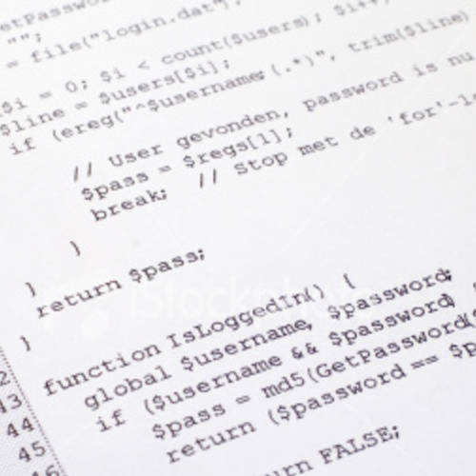

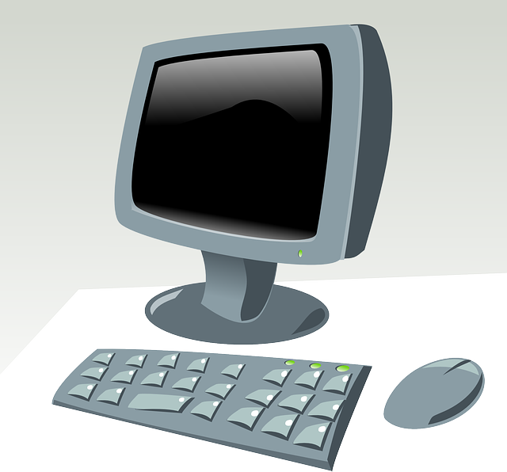

What is Compilation?
Source code
Binary
compiled + linked
compiler
and OS
libraries
uses
run on

Slide 28

Static Linking
Source code
Static binary
compiled + static linking
compiler
and OS
libraries
run anywhere

Slide 29
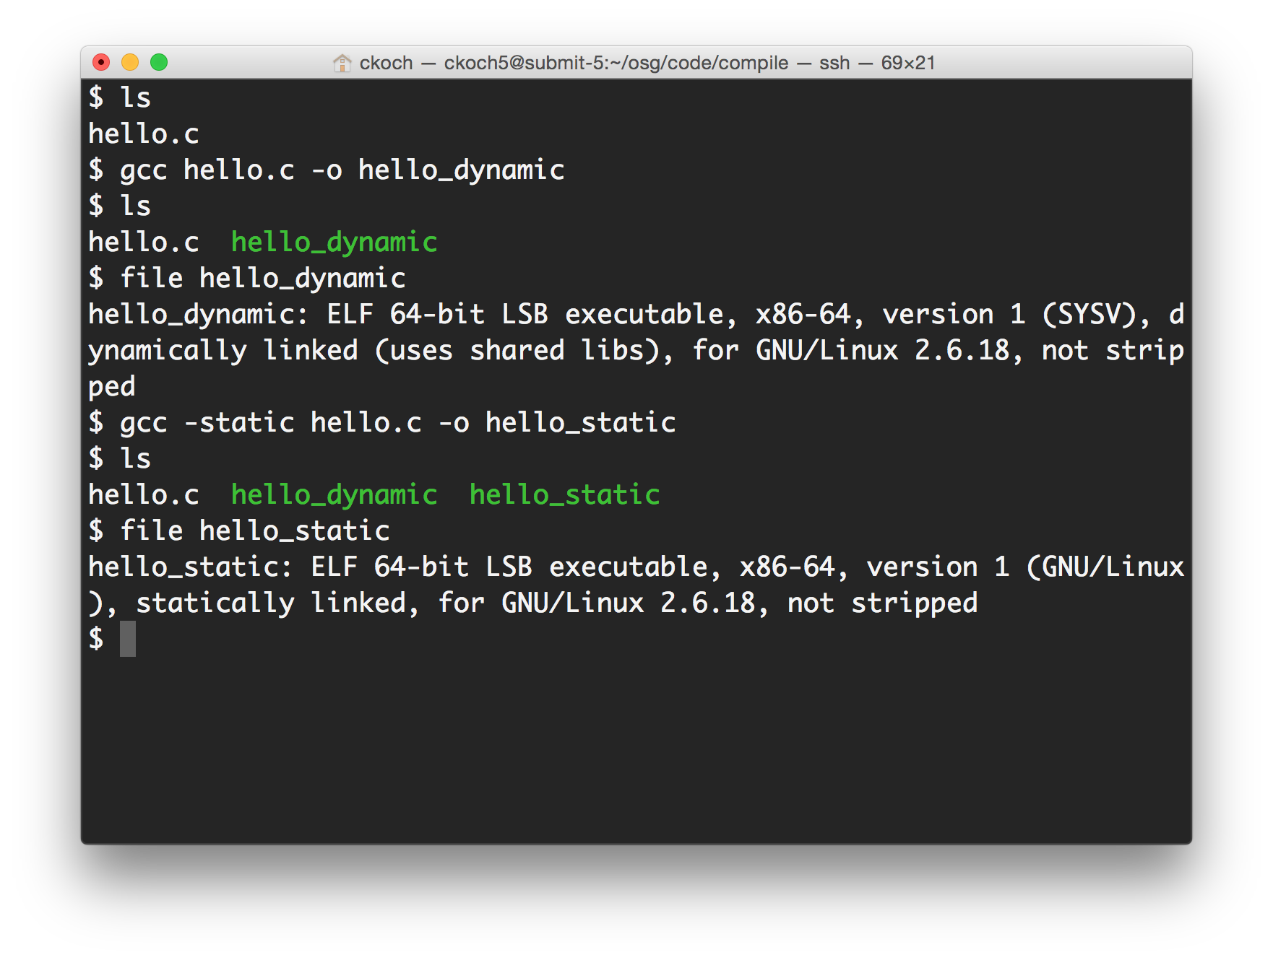
Compilation (command line)

Slide 30

Single Binary Workflow
Execute server
Option 1
Submit server
compile
Static binary
Option 2
download

Slide 31
Use Wrapper Scripts
Method 2

Slide 32
Set up software with every job
Good for software that:
Can’t be statically compiled / compiled to one file
Uses interpreted languages (Matlab, Python, R)
Any software with instructions for local installation
Method: write a wrapper script
Contains a list of commands to execute
Typically written in bash or simple perl/python (usually common across operating systems/versions)

Slide 33
Wrapper scripts
Set up software in the working directory
Unpack pre-built installation OR
Just use normal compiled code
Run software
Besides software: manage data/files in the working directory
Move or rename output
Delete installation files before job completion

Slide 34


Wrapper script workflow
Execute server
Submit server
set up run
wrapper script
set up run
source code, compiled code or pre-built install
set up run

Slide 35
When to pre-build?
Pre-built installation (recommended)
Install with every job (variable results)
Install once, use in multiple jobs
Faster than installing from source code within the job
Jobs must run on a computer similar to where the program was built
Computers must have appropriate tools (compilers, libraries) for software to install
Can run on multiple systems, if these requirements are met
Longer set-up time

Slide 36
Preparing your code
Where do you compile/pre-build code? Test your wrapper script?
Guiding question: how computationally intensive is the task?
Computationally intensive (takes more than a few minutes, as a rule of thumb)
Run as interactive job, on a private computer/server, or with a queued job
Computationally light (runs in few minutes or less)
Run on submit server (or above options, if desired)

Slide 37
Exercises
Software is a compiled binary
Exercise 3.1: statically compile code and run (C code)
Exercise 3.2: download and run pre-compiled binary (BLAST)

Slide 38
Exercises
Introduction to using wrapper scripts
Exercise 3.3: use a wrapper script to run previously downloaded software (BLAST)
Portable installation and wrapper scripts
Exercise 3.4: create a pre-built software installation, and write a wrapper script to unpack and run software (OpenBUGS)

Slide 39
Exercises
Exercise 3.5 (optional)
Using arguments with wrapper scripts

Slide 40
Questions?
Now: Hands-on Exercises
1:45-3:00pm
Next:
3:00 - 3:15pm: Break
3:15 - 5:00pm: Interpreted languages

